Slide 1
Artist research

Slide 2
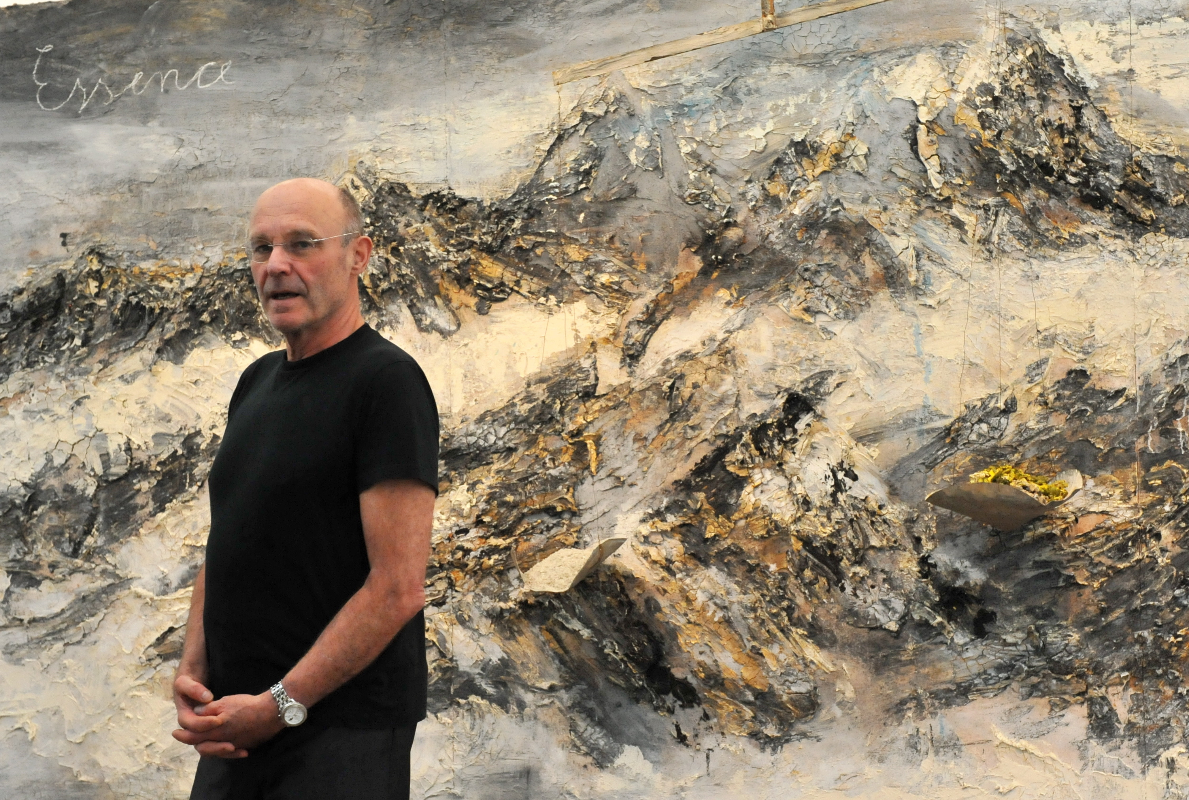
Anselm Kiefer
History speaks to artists. It changes the artist's thinking and is constantly reshaping it into different and unexpected images.
Anselm Kiefer

Slide 3
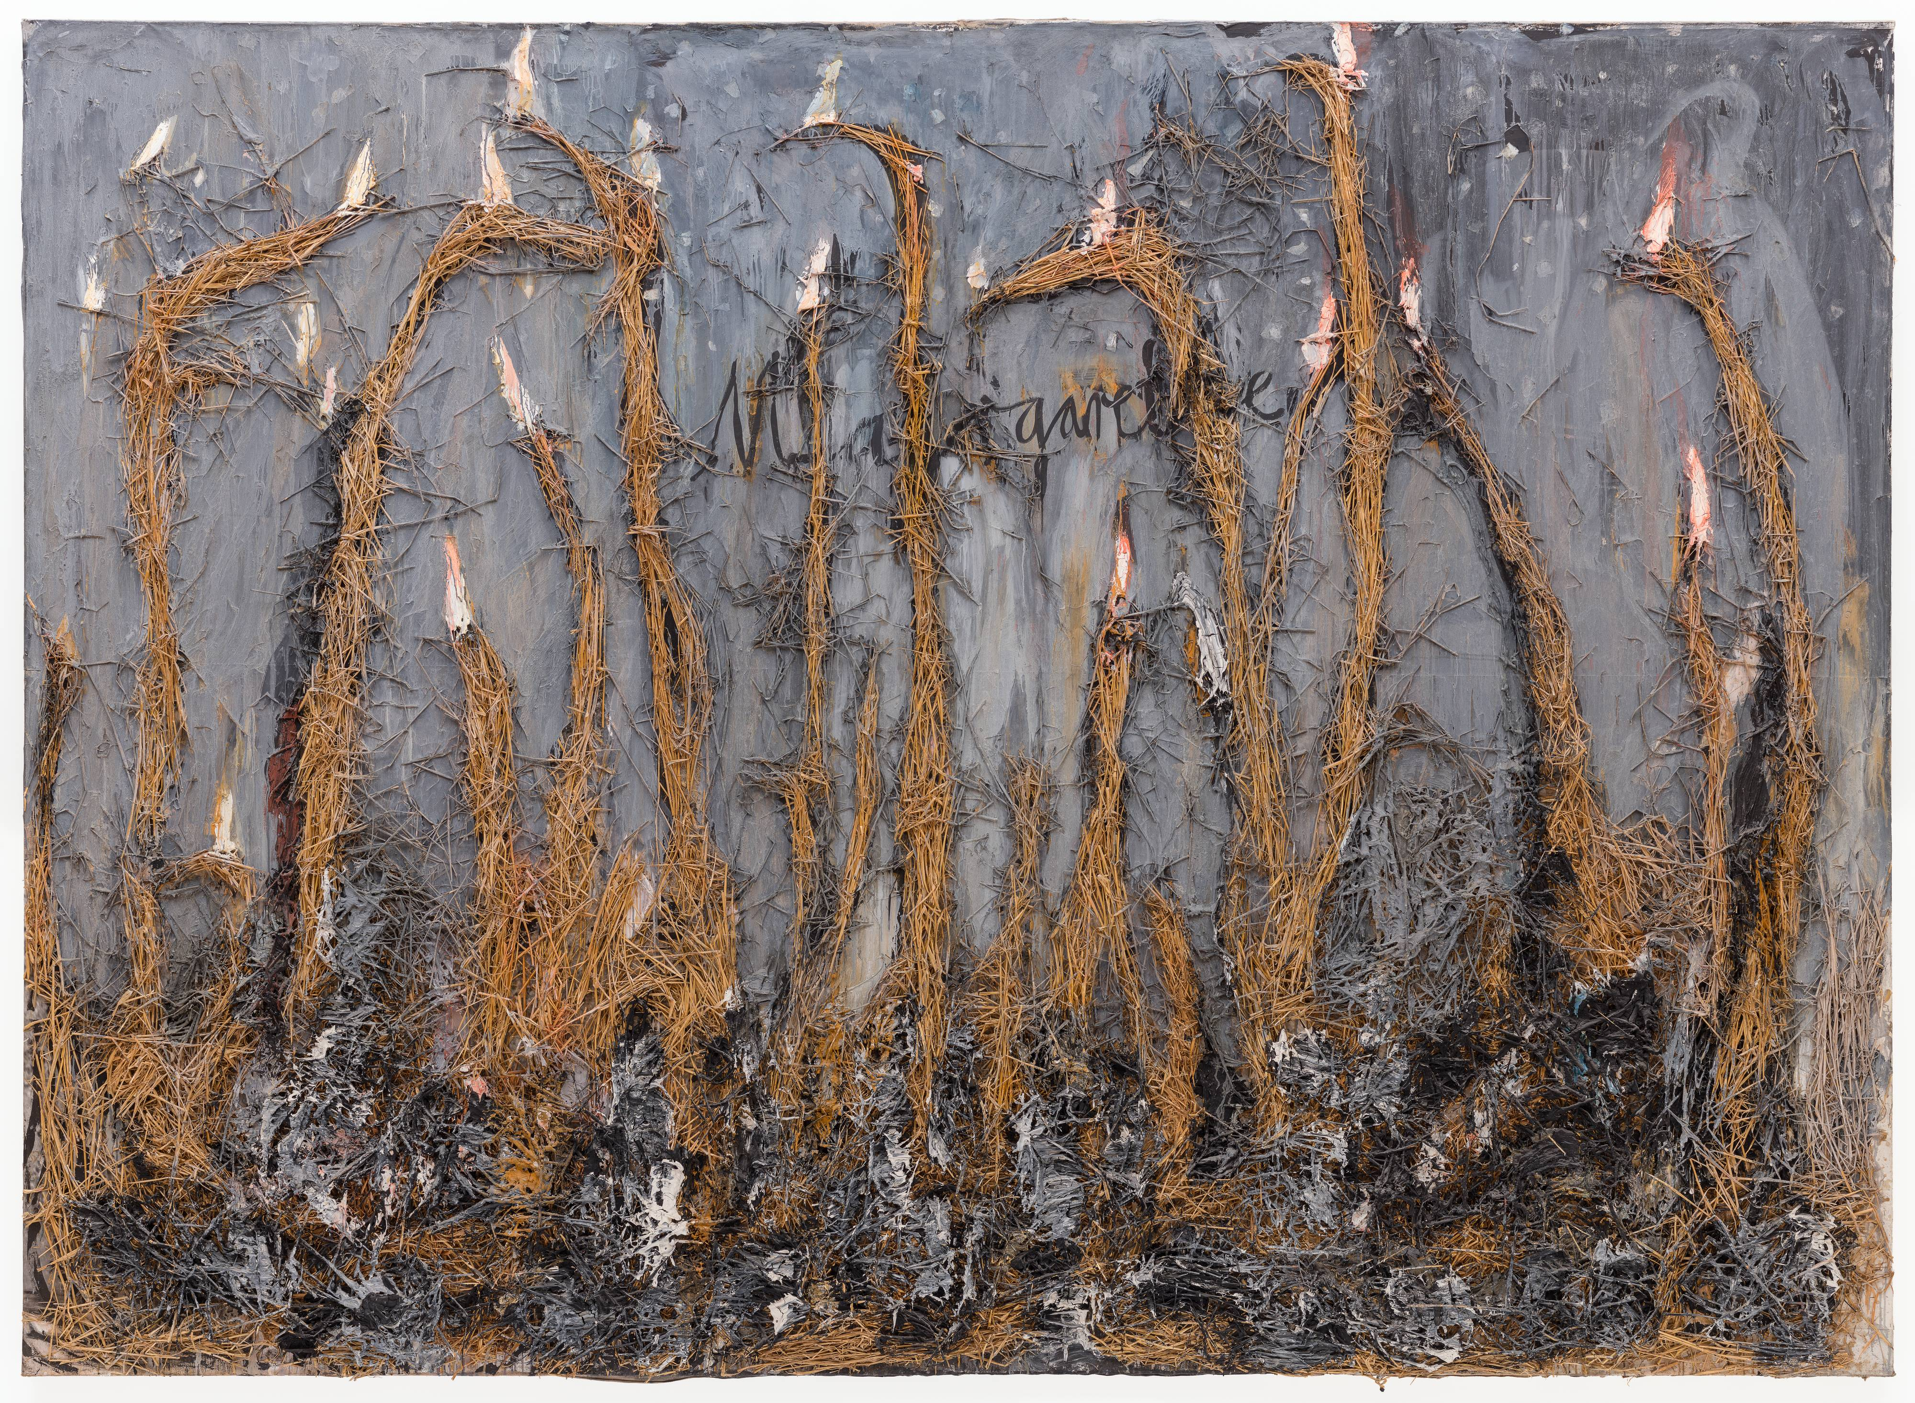
Death Fugue Black milk of daybreak we drink it at evening we drink it at midday and morning we drink it at night we drink and we drink we shovel a grave in the air there you won't lie too cramped A man lives in the house he plays with his vipers he writes he writes when it grows dark to Deutschland your golden hair Marguerite he writes it and steps out of doors and the stars are all sparkling he whistles his hounds to come close he whistles his Jews into rows has them shovel a grave in the ground he orders us strike up and play for the dance Black milk of daybreak we drink you at night we drink you at morning and midday we drink you at evening we drink and we drink A man lives in the house he plays with his vipers he writes he writes when it grows dark to Deutschland your golden hair Margeurite your ashen hair Shulamith we shovel a grave in the air there you won't lie too cramped He shouts jab this earth deeper you lot there you others sing up and play he grabs for the rod in his belt he swings it his eyes are blue jab your spades deeper you lot there you others play on for the dancing Black milk of daybreak we drink you at night we drink you at midday and morning we drink you at evening we drink and we drink a man lives in the house your goldenes Haar Margeurite your aschenes Haar Shulamith he plays with his vipers He shouts play death more sweetly Death is a master from Deutschland he shouts scrape your strings darker you'll rise then in smoke to the sky you'll have a grave then in the clouds there you won't lie too cramped Black milk of daybreak we drink you at night we drink you at midday Death is a master aus Deutschland we drink you at evening and morning we drink and we drink this Death is ein Meister aus Deutschland his eye it is blue he shoots you with shot made of lead shoots you level and true a man lives in the house your goldenes Haar Margarete he looses his hounds on us grants us a grave in the air he plays with his vipers and daydreams der Tod is ein Meister aus Deutschland dein goldenes Haar Margarete dein aschenes Haar Shulamith Paul Celan
Artwork title: Margarethe Date created1981ClassificationpaintingMediumoil, straw, emulsion, and gelatin silver print on linenDimensions114 1/4 in. x 157 3/4 in. (290.2 cm x 400.69 cm)

Slide 4
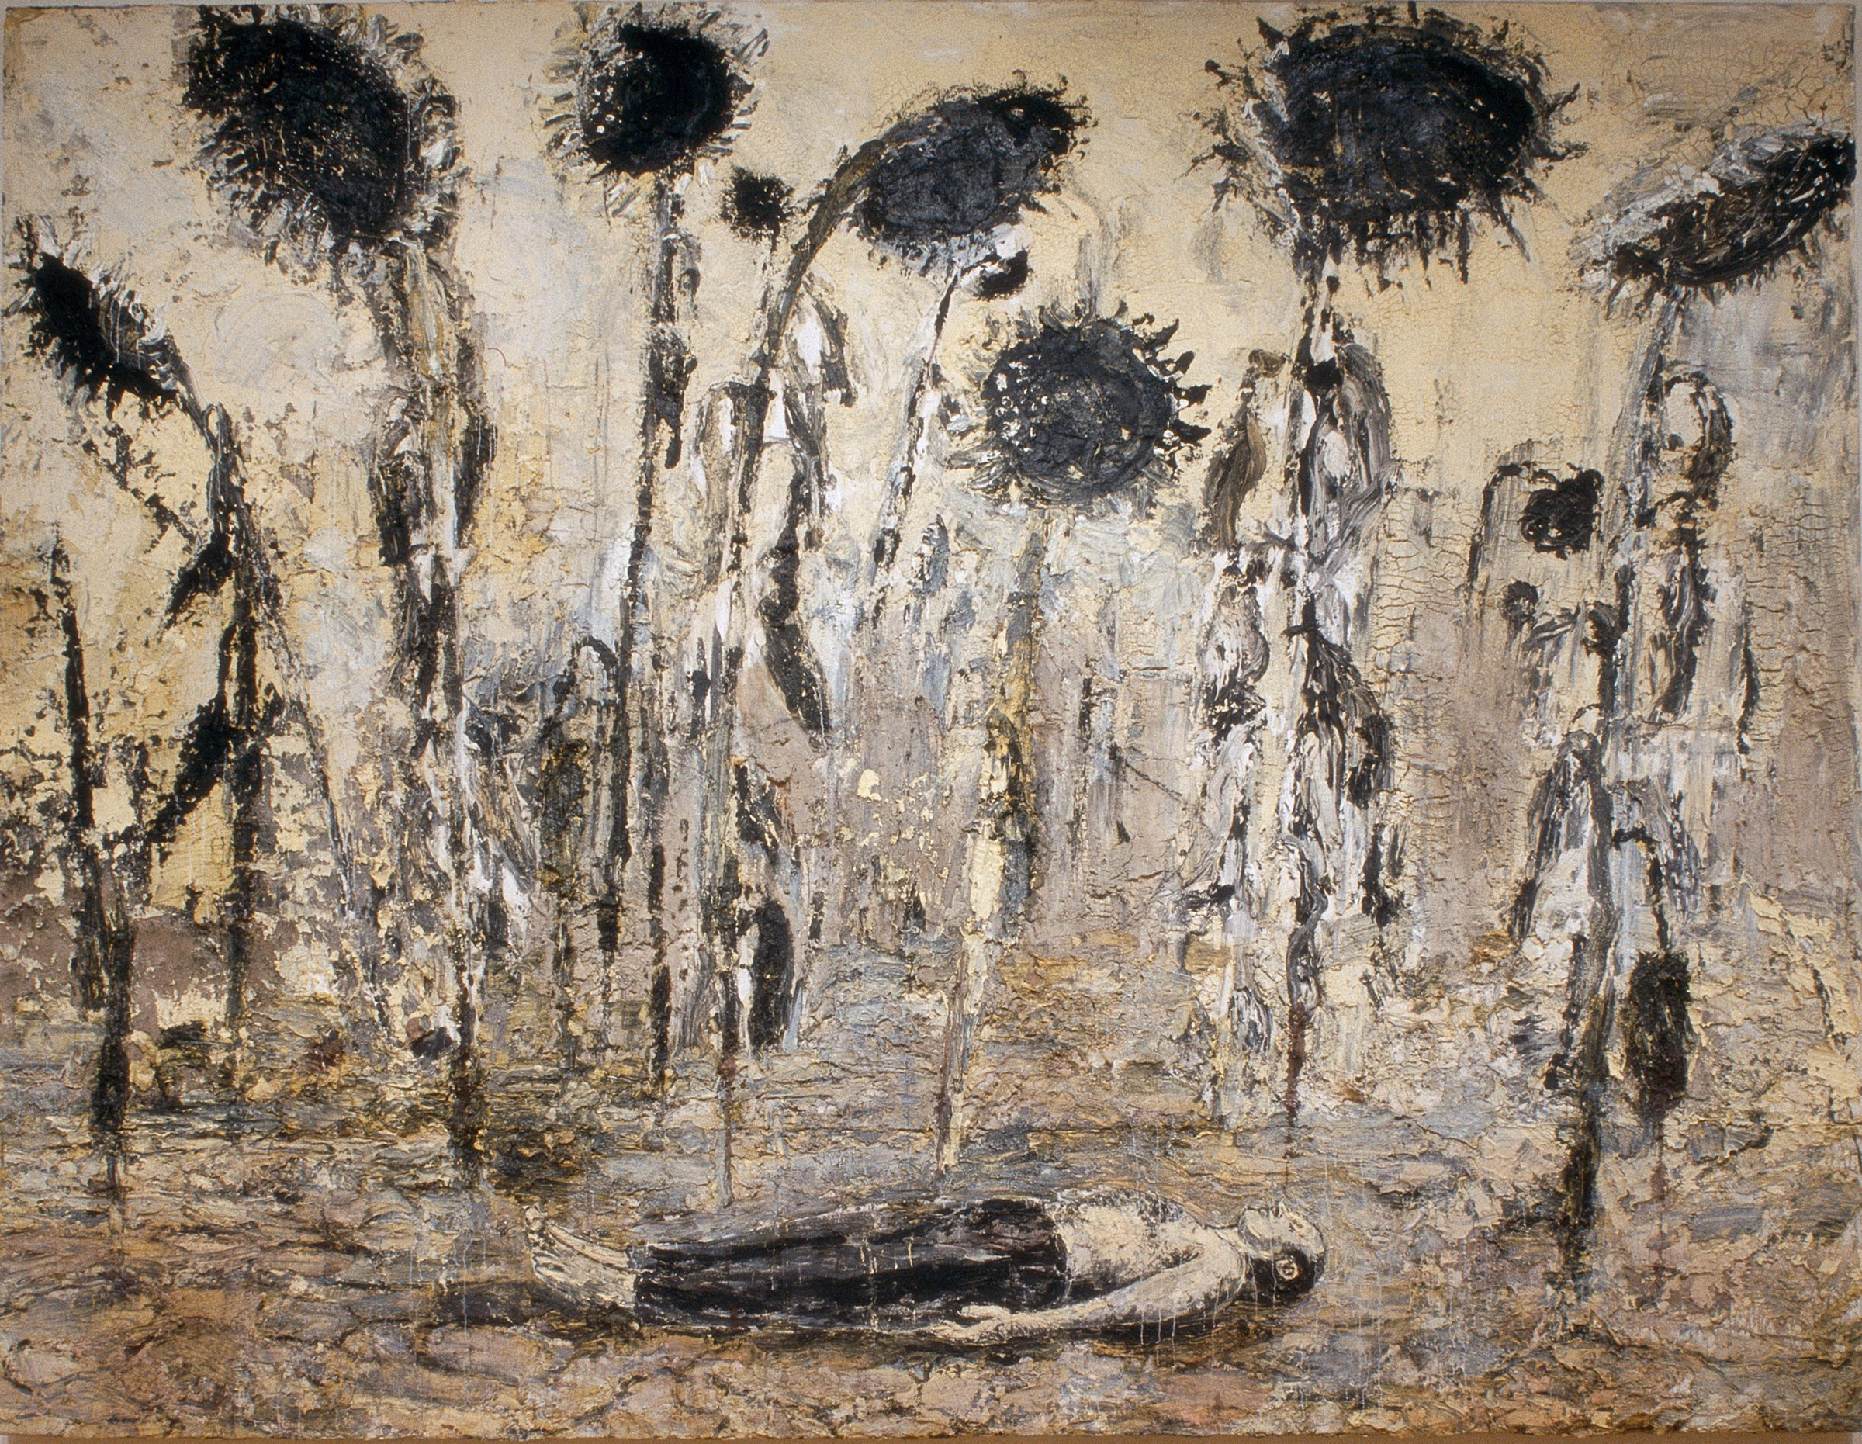
Anselm Kiefer, The Orders of the Night (Die Orden der Nacht), 1996, emulsion, acrylic, and shellac on canvas, 140 ⅜ × 182 ⅜ inches (356 × 463 cm). Photo: © Seattle Art Museum
Anselm Kiefer’s monumental body of work represents a microcosm of collective memory, visually encapsulating a broad range of cultural, literary, and philosophical allusions as well as symbols from religion, mysticism, mythology, history, and poetry.
Ruins, for me, are the beginning. With the debris, you can construct new ideas. They are symbols of a beginning.
Anselm Kiefer

Slide 5
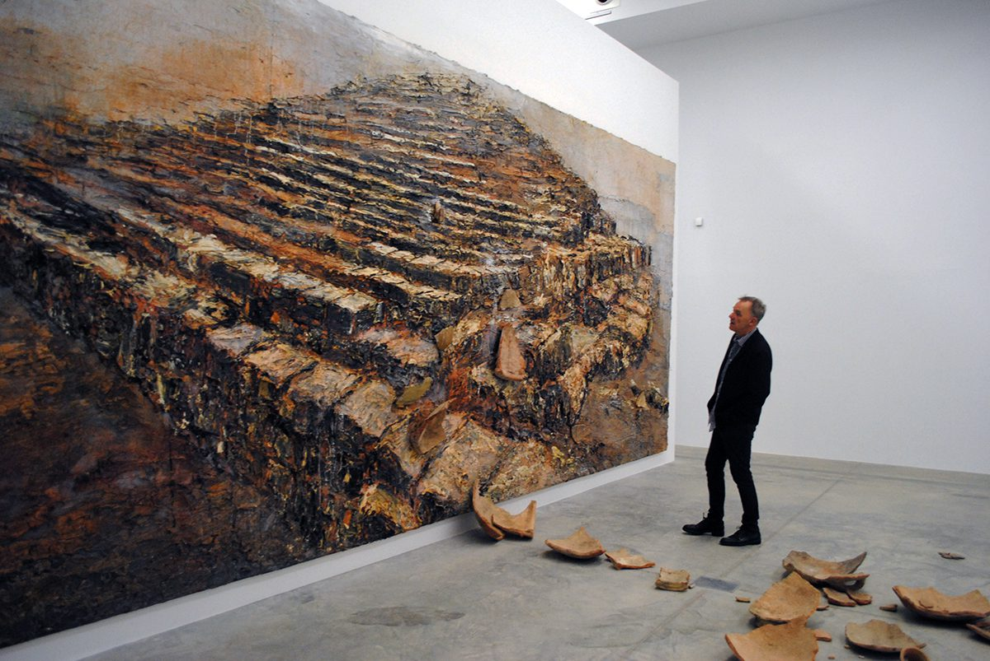
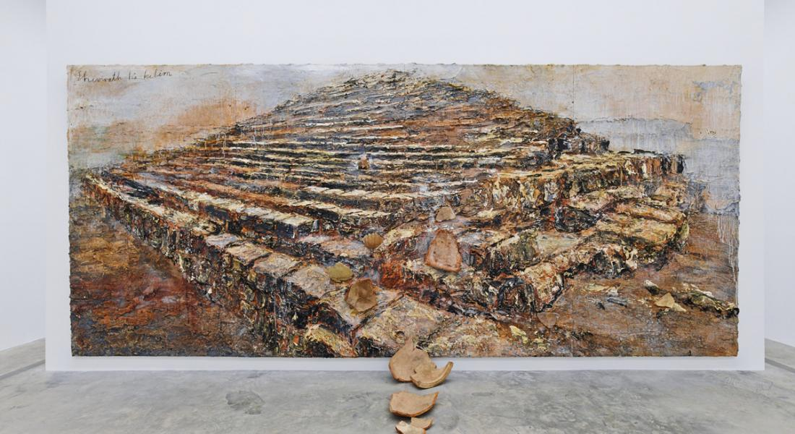
Kiefer’s themes have included German history and the horror of the Holocaust. The artist studied with Joseph Beuys and Peter Dreher during the 1970s.
Image: Anselm Kiefer, ‘Shevirath Ha Kelim’ (2009), Kiefer Pavilion, PLANTA project, Fundació Sorigué, Lleida, Spain. Photo: P A Black © 2018

Slide 6
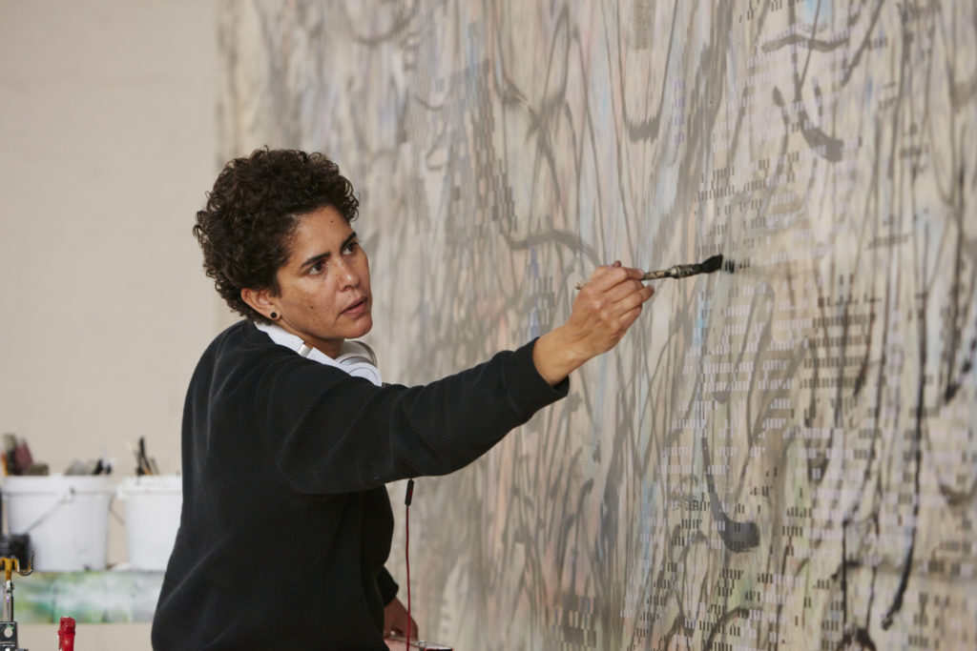
Julie Mehretu
That's what I'm interested in: the space in between, the moment of imagining what is possible and yet not knowing what that is.
Julie Mehretu

Slide 7
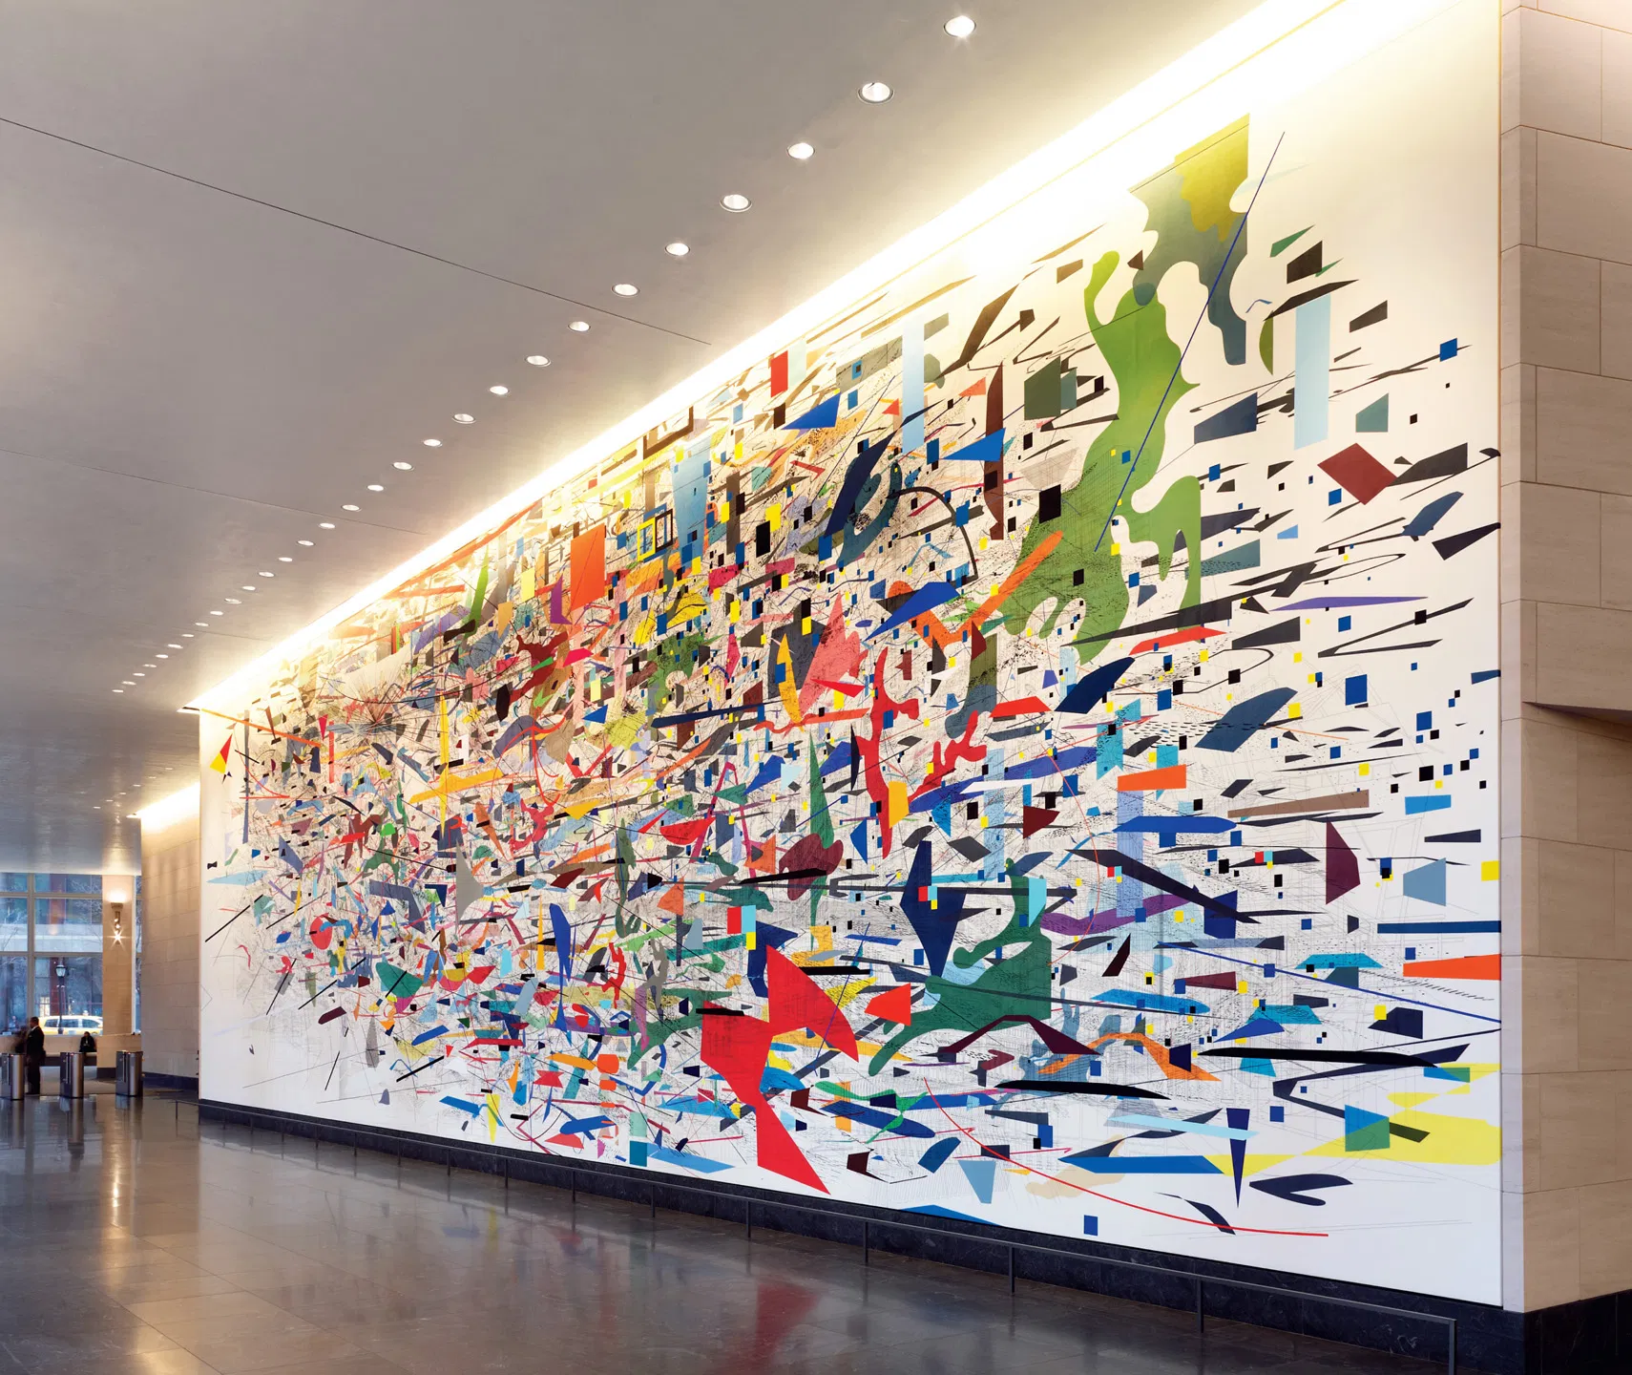
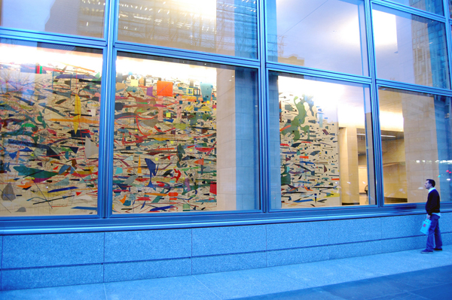
Arts and literature
I don't ever work in a way where something is an illustration of an event, but when something is occurring at the same time I see it as very informed by that.
Julie Mehretu
Mural commissioned by Goldman Sachs and tracing the history of capitalism, at more than 24 metres long and 7 metres high.

Slide 8
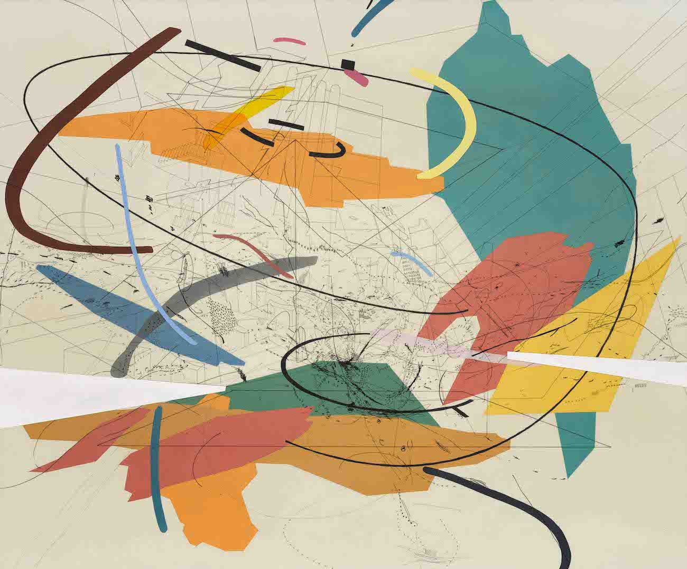
The progression of Mehretu’s style from early pieces that focus more heavily on mapping and drawing to her more recent sprawling abstractions with innumerable layers of visual information.
Julie Mehretu, Untitled 2 (1999) © Julie Mehretu. Courtesy of White Cube.

Slide 9
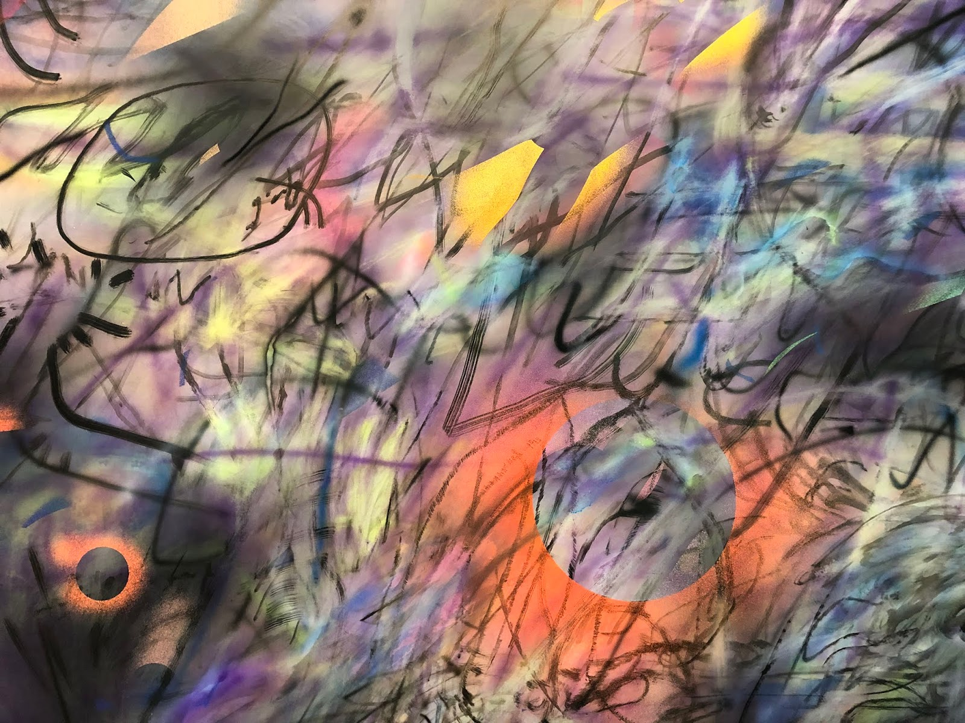
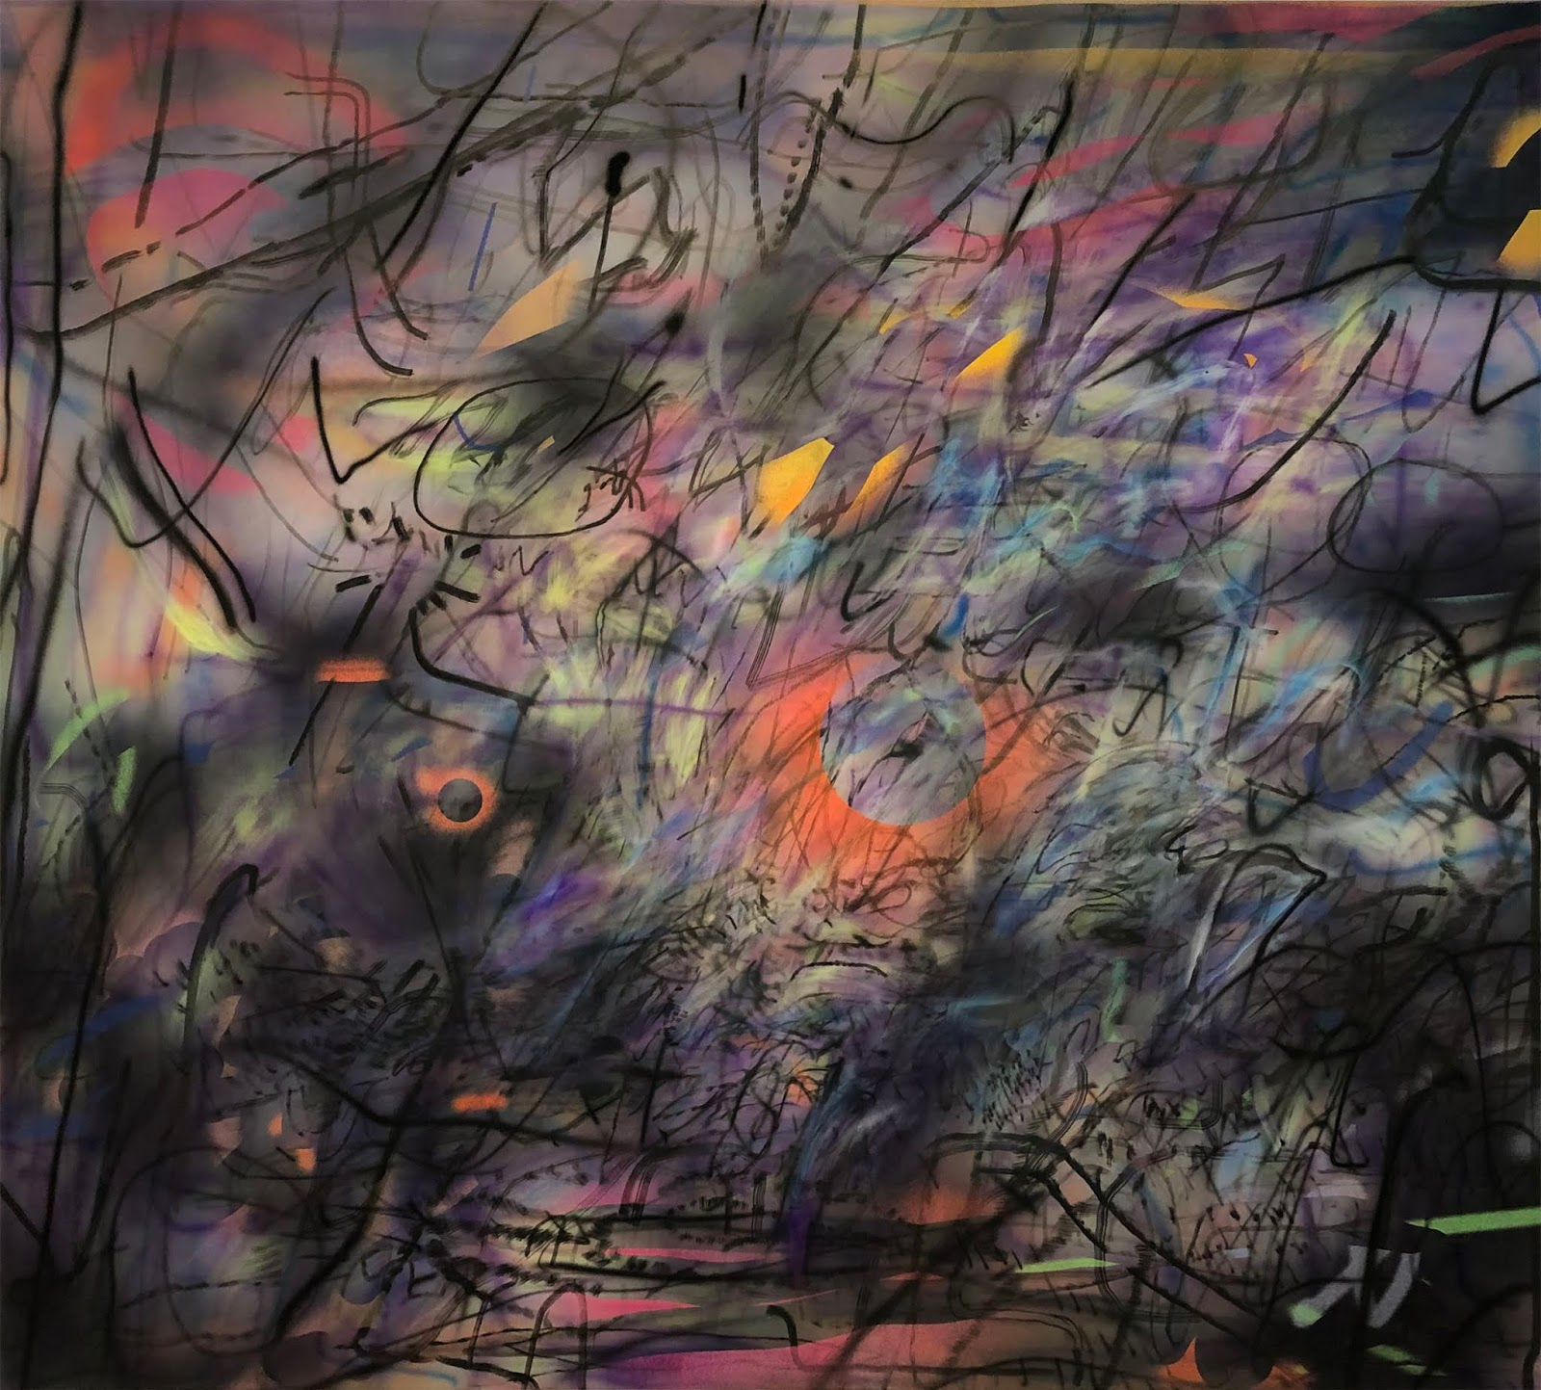
.
Small detail of Julie Mehretu's Sun Ship (J.C.), 2018
In Mehretu's words: "There's a subconscious terror that you feel vibrating close to the surface.… More than I've ever felt in my lifetime here in the U.S. It's seeping into everything. I feel like that is what I'm trying to metabolize in these new paintings.”
Julie Mehretu, Sun Ship (J.C.), 2018

Slide 10
Citations
https://www.brainyquote.com/quotes/anselm_kiefer_505224 https://poets.org/poem/death-fugue https://gagosian.com/quarterly/2014/10/06/anselm-kiefer-royal-academy-art/
https://www.sfmoma.org/artwork/FC.595/
https://www.artlyst.com/features/anselm-kiefer-monumental-paintings-rising-industrial-moonscape-planta-paul-black/ https://www.omenkaonline.com/artist-dossier-julie-mehretu/
https://www.theartnewspaper.com/review/three-exhibitions-to-see-in-new-york-this-weekend-19-march
http://lacmaonfire.blogspot.com/2019/12/mehretu-and-subconscious-terror.html
https://www.omenkaonline.com/artist-dossier-julie-mehretu/
https://www.brainyquote.com/quotes/julie_mehretu_536029
https://www.ronifeinstein.com/book/julie-mehretu/

