Slide 1
Artist Working With Memory
Kim Holmes

Slide 2
Cecily Brown
The place I’m interested in is where the mind goes when it’s trying to make up for what isn’t there. —Cecily Brown

Slide 3
“The whole figurative/abstract thing is about not wanting to name something, not pin it down. I’ve never wanted to let go of the figure, but it keeps wanting to disappear. It’s always a fight to hold on.”
Title: Girl on a Swing, 2004 Medium: oil on linen
Dimensions: 182.88 × 243.84 cm (72 × 96 in.)
Title: Girl on a Swing #2 Medium: oil on linen
Dimensions: 78 x 90 in. (198.12 x 228.6 cm)

Slide 4
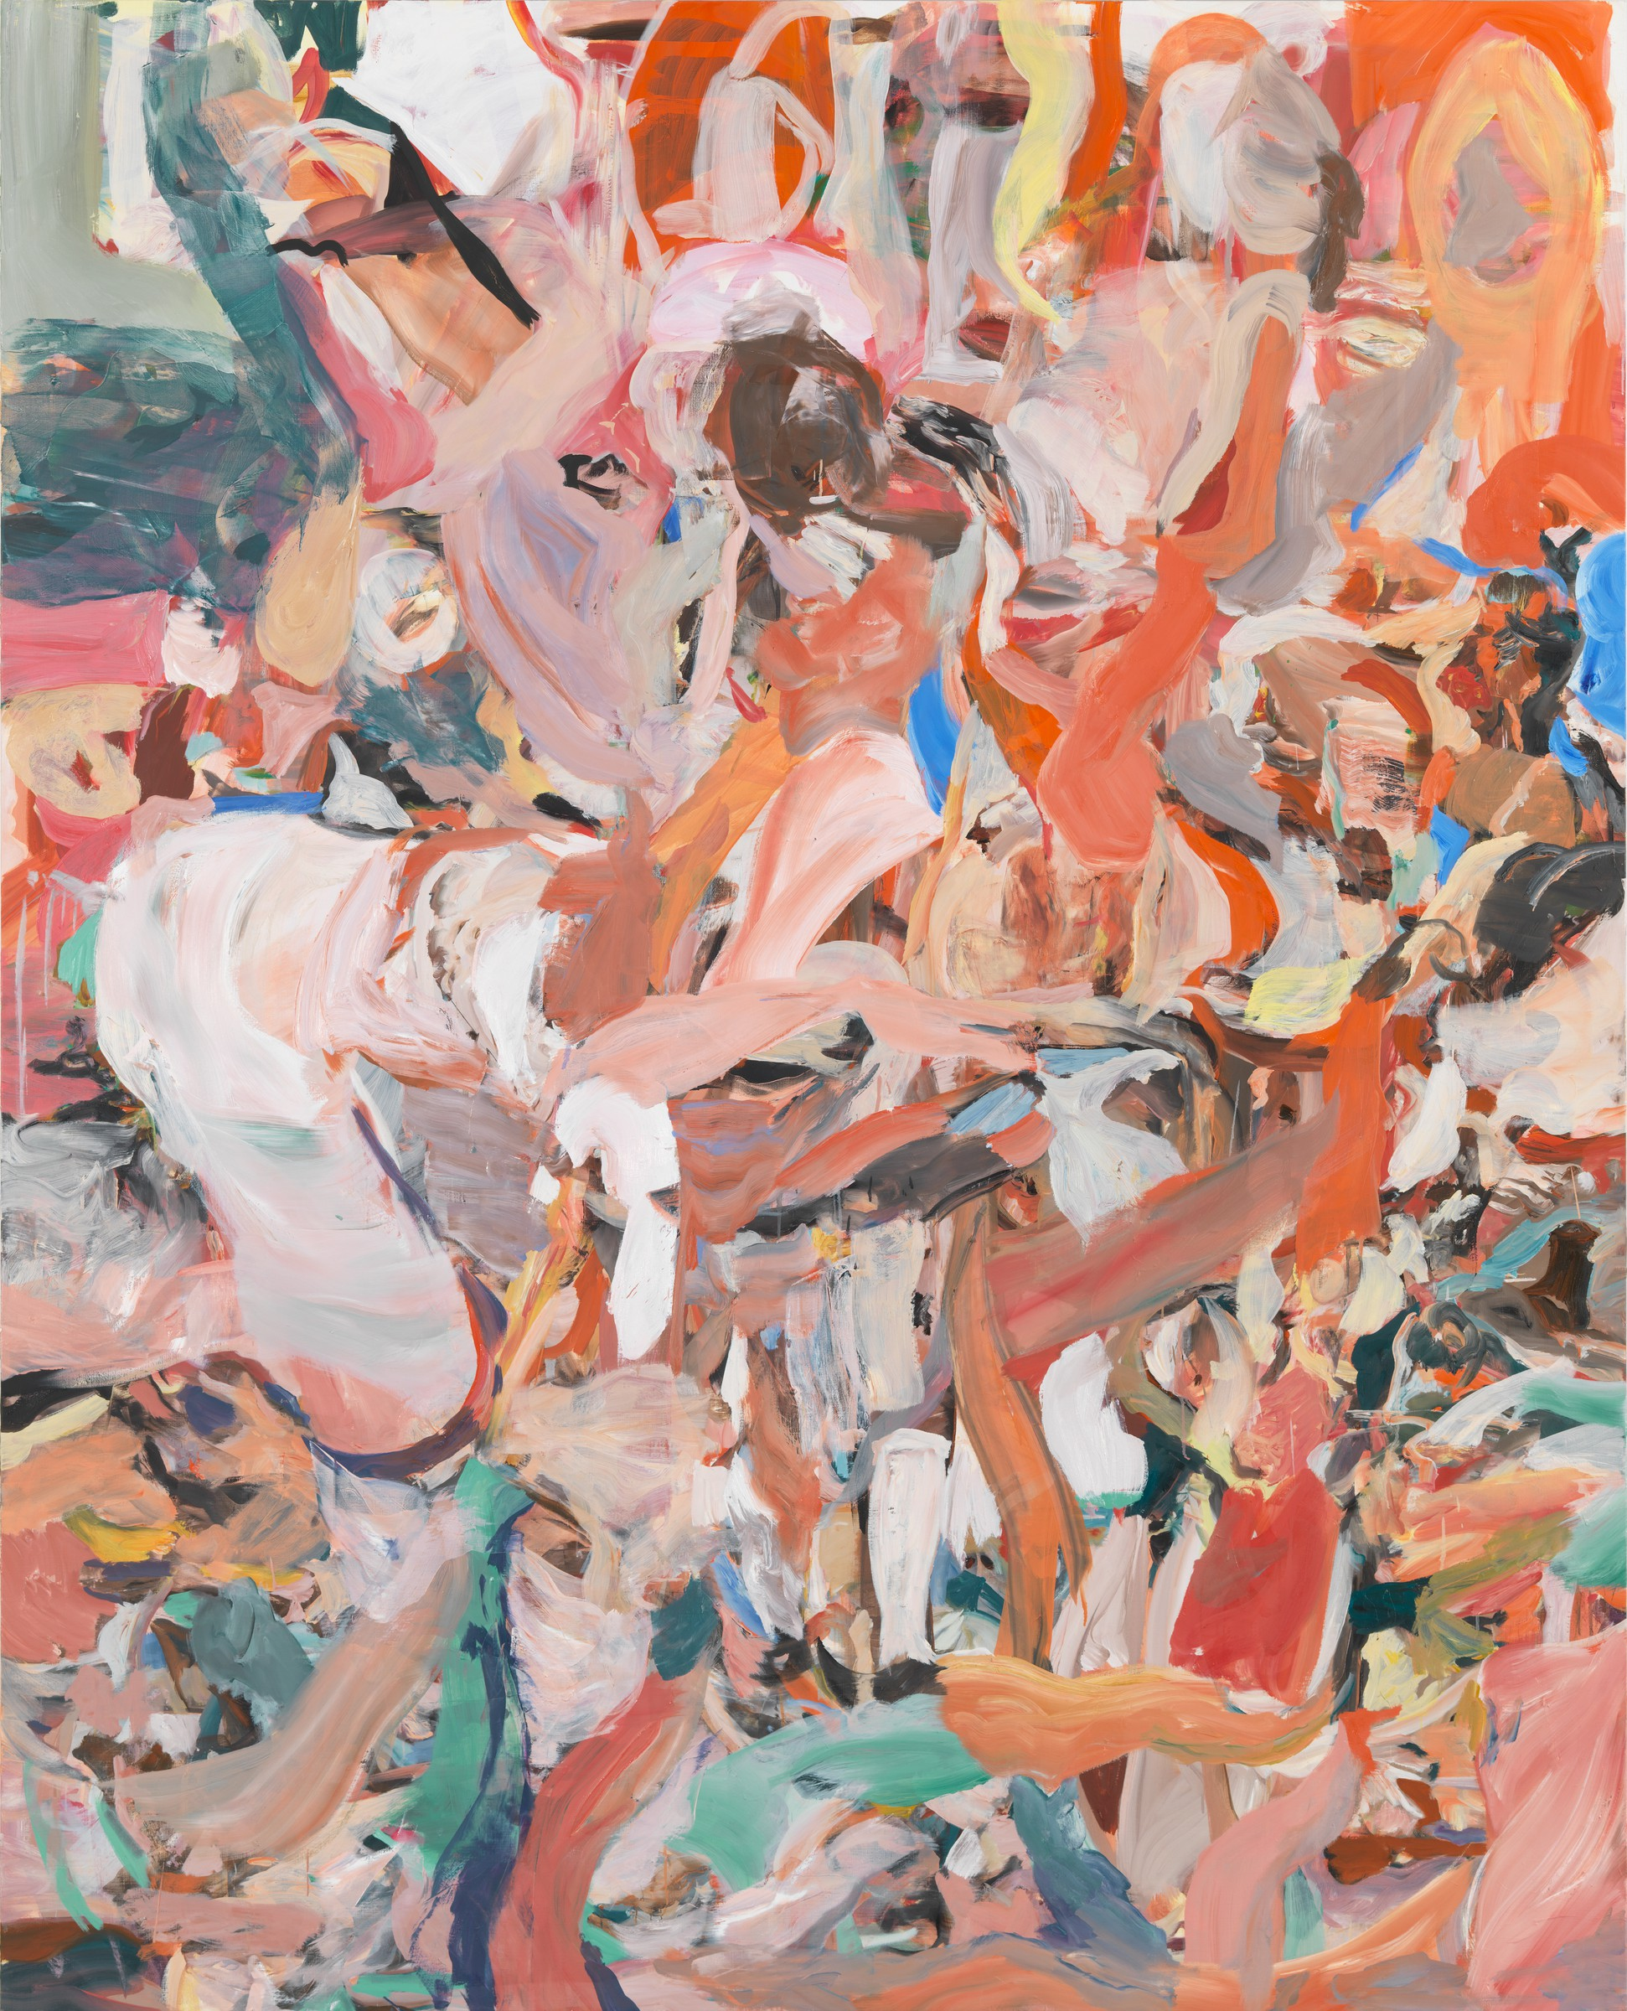
Title: The Girl and Goat, 2013-2014 Medium: Oil on linen Dimensions: 97 × 89 in 246.4 × 226.1 cm
Title: Breathless Noon, 2014, Medium: oil on linen Dimensions: 83 × 67 inches (210.8 × 170.2 cm).
CECILY BROWN’S WORK CONFRONTS A VARIETY OF CONTENT WITH DEEP INSIGHT INTO THE SURROUNDING REALITY AND THROUGH AN INTIMATE MEDITATION, A PSYCHOLOGICAL AND INTROSPECTIVE ATTITUDE TOWARD THE HUMAN SOUL.
Danilo Eccher

Slide 5
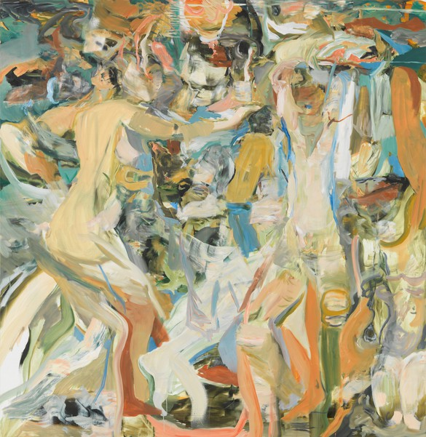
Title: The river’s tent is broken, 2014,
Medium: oil on linen, Dimensions: 67 × 65 inches (170.2 × 165.1 cm
“The river’s tent is broken: the last fingers of leaf Clutch and sink into the wet bank. The wind Crosses the brown land, unheard. The nymphs are departed.”
'The Fire Sermon' is the third section of T. S. Eliot's ground-breaking 1922 poem The Waste Land. Its title is chiefly a reference to the Buddhist Fire Sermon, which encourages the individual to liberate himself (or herself) from suffering through detachment from the five senses and the conscious mind.

Slide 6
Anna Bjerger

Slide 7
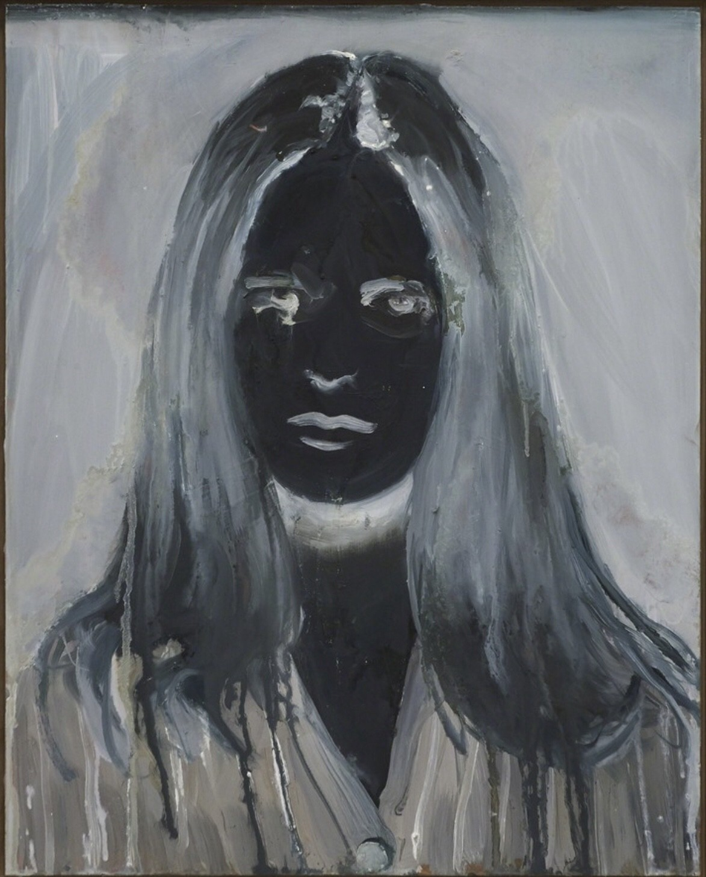
Title: Negative
(2016)
Title: Halo(2015) Medium: oil on aluminum, Dimensions: 50 x 40 cm

Slide 8
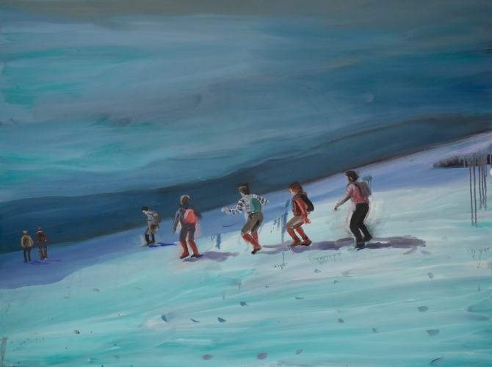
Title: Giant (2017) Medium: Oil on aluminum Dimensions: 105 x130 cm
Title: Trek Medium: Oil on aluminum Dimensions: 90 x120 cm

Slide 9
Title: Nightfall, 2020 Medium: Oil on aluminium, Dimensions: 154 cm x 309 cm, ABM-20-005

Slide 10
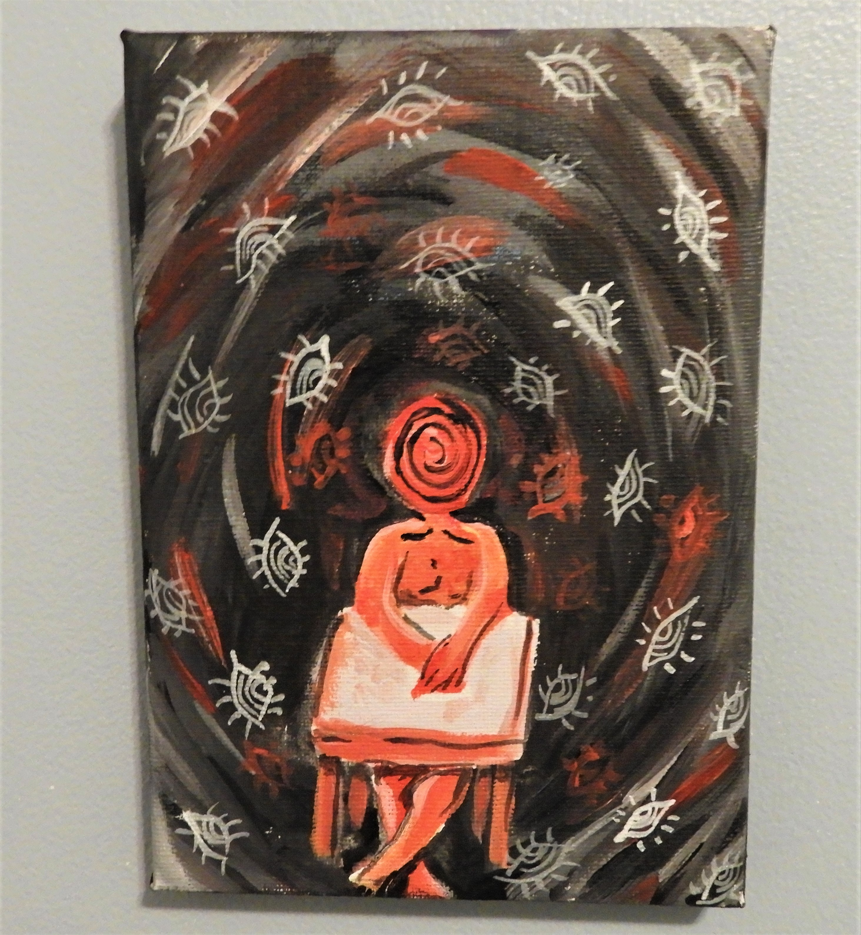
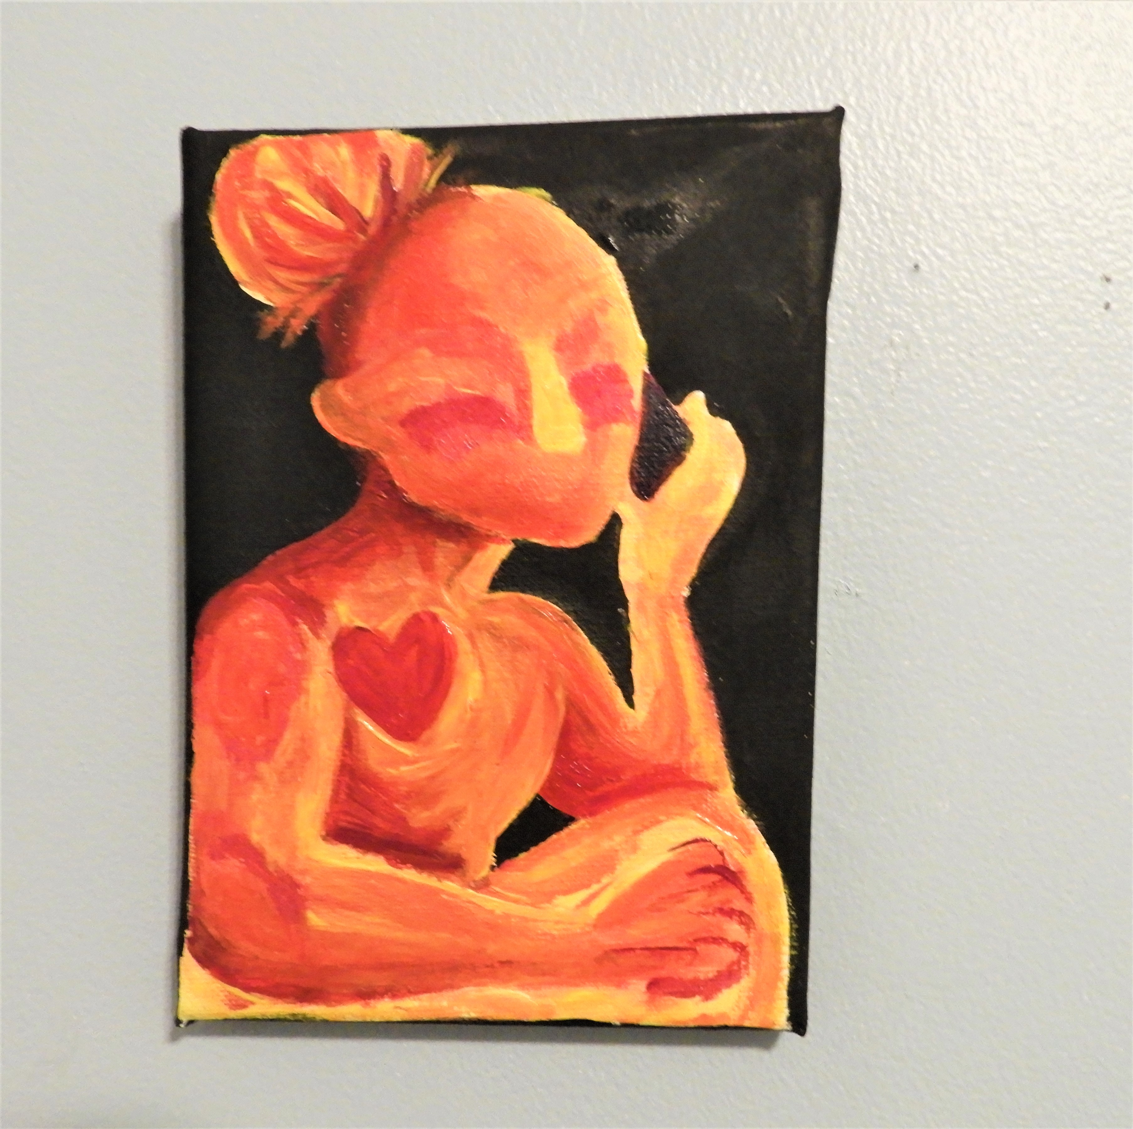
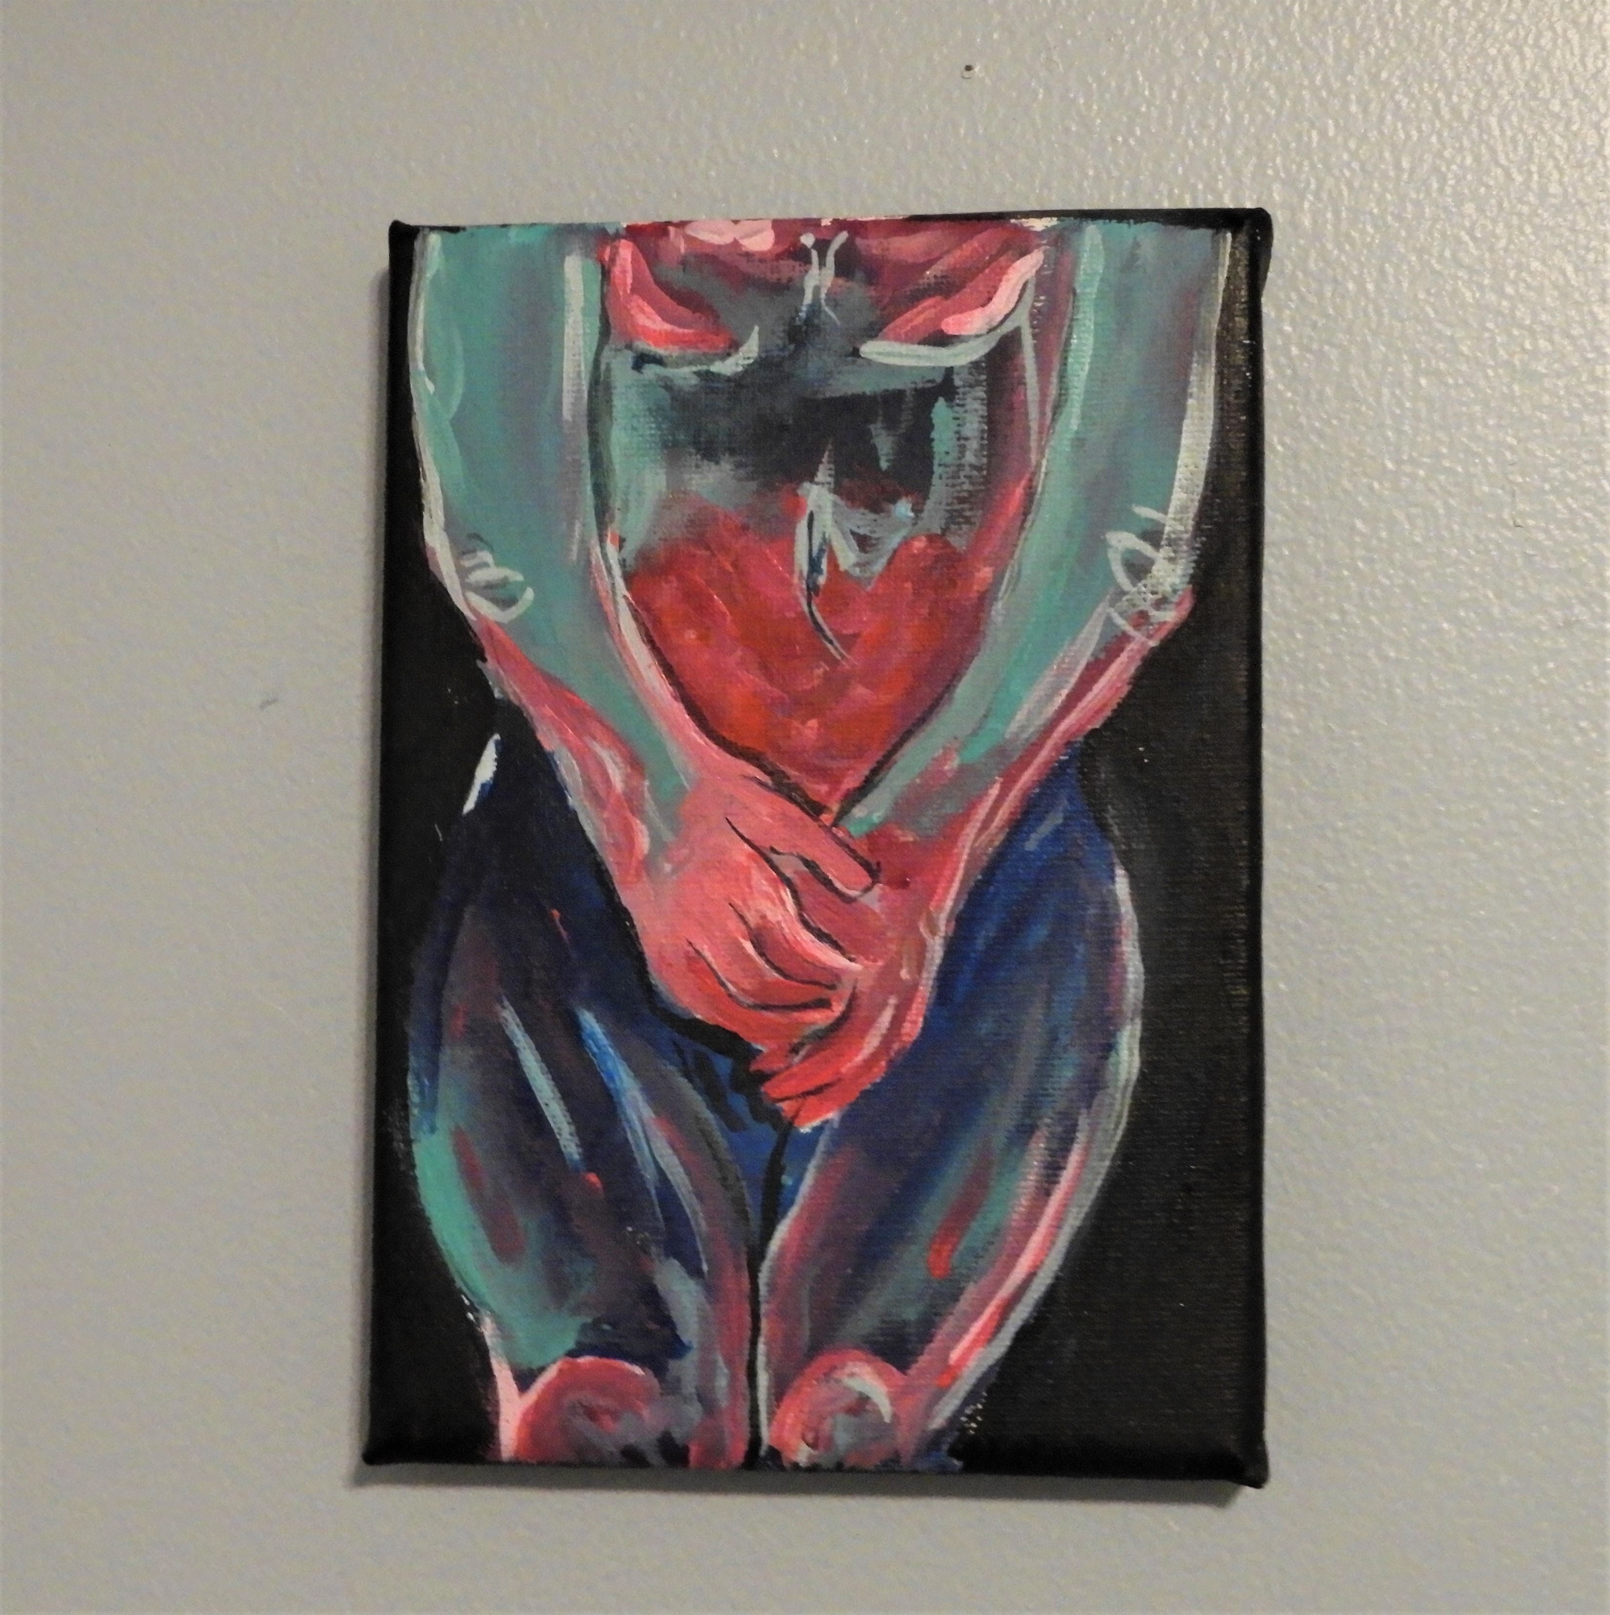
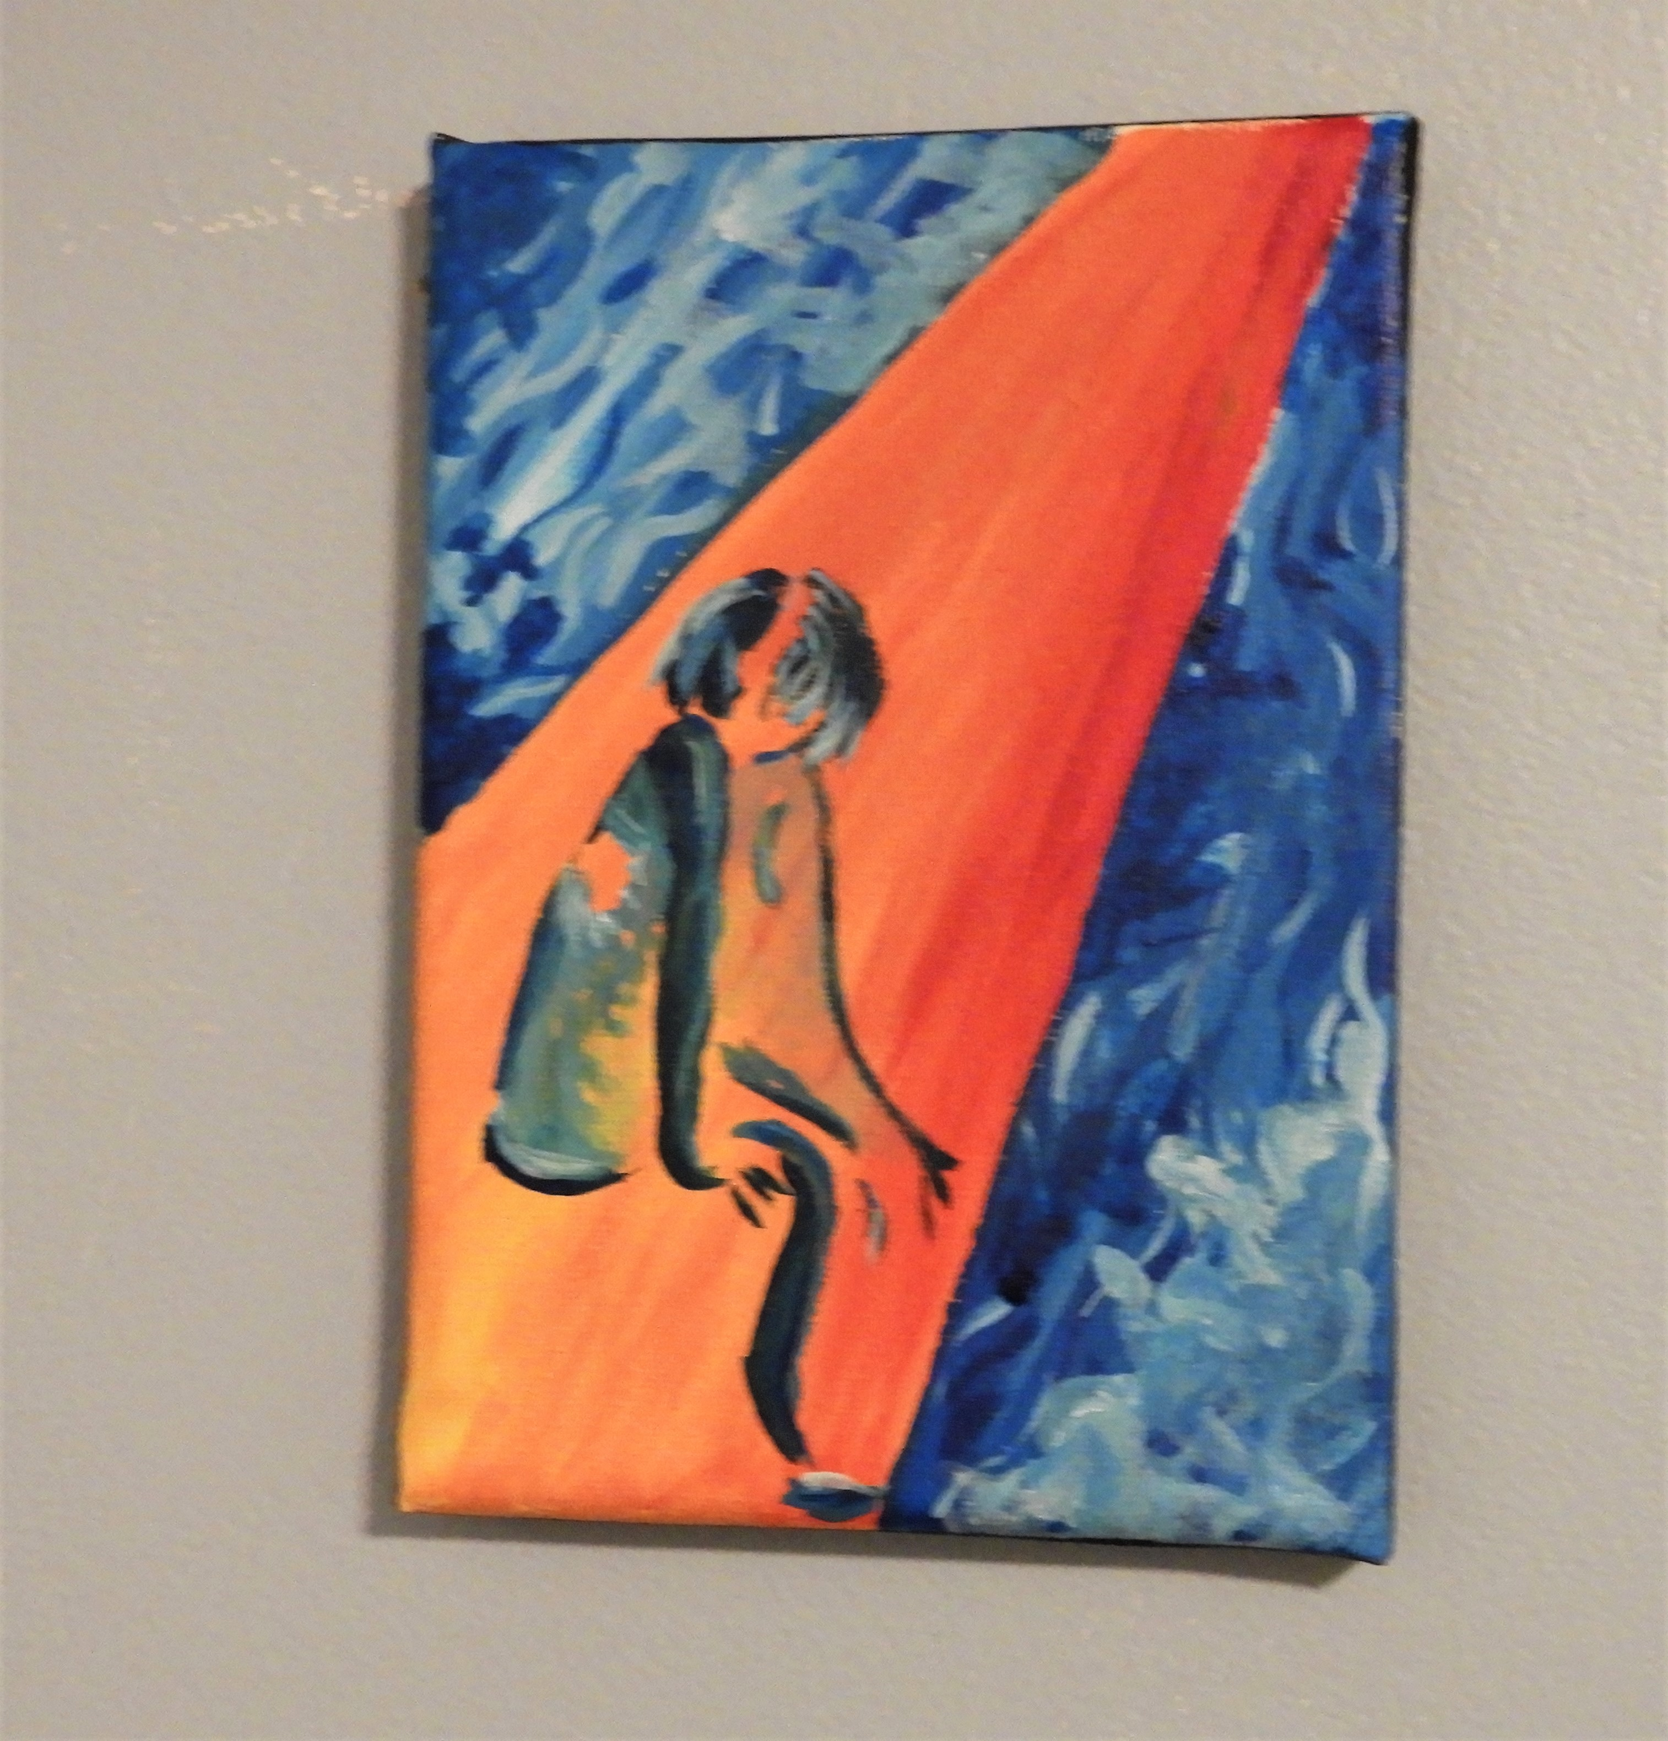
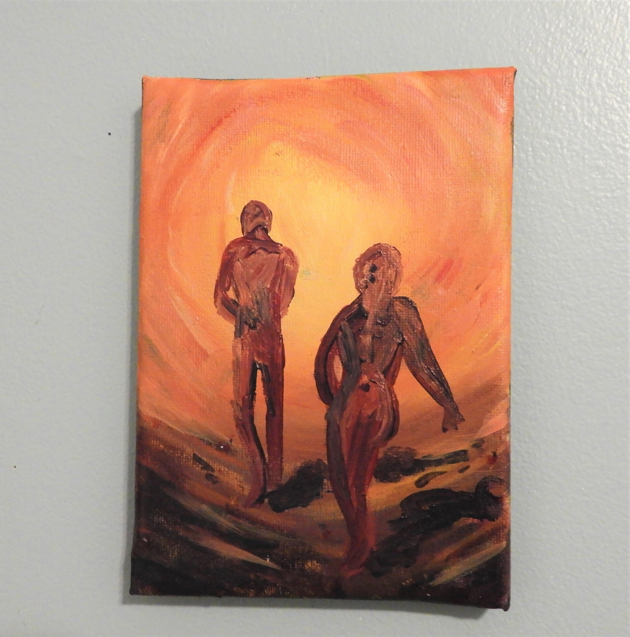
Thank you
Kim Holmes

Slide 11
Citation page
https://mizmaude.wordpress.com/2017/05/12/art-of-the-week-cecily-browns-the-rivers-tent-is-broken-tells-you-stories/
https://www.sothebys.com/en/artists/cecily-brown
https://gagosian.com/quarterly/2014/10/22/cecily-brown-turin/
https://www.sothebys.com/en/artists/cecily-brown
https://www.artsy.net/artwork/cecily-brown-the-girl-and-goat
https://www.editioncopenhagen.com/1194/anna-bjerger_original_prints_and_lithographs_for_sale
https://www.artsy.net/article/artsy-editorial-these-20-female-artists-are-pushing-figurative-painting-forward

